Slide 1
Vulcan
Vulcan
Yixuan Liu-B01656458
Yifan Jiang-B01658285
Haoming Li-B01657745
Letian Wang-B01655438

Slide 2
1
Chapter 01
Introduction

Slide 3
Introduce
01
02
03
04
What is Vulcan.js?
Development background of Vulcan.js
When is it suitable to use Vulcan.js?
Disadvantages of using Vulcan.js

Slide 4
What is vulcan.js?
01
Vulcan.js is a full-line development framework based on JavaScript for building modern web applications.
Development background of Vulcan.js
02
The development background of vulcan.js can be traced back to Meteor.js, a popular full-stack JavaScript development framework.

Slide 5
03 When is it suitable to use Vulcan.js?
1. Need to develop quickly:
Vulcan.js provides a complete set of development tools and preset functions, enabling developers to build a fully functional Web application faster.
Appropriate
Plentiful
2. Flexibility and customisation are required:
Vulcan
Vulcan.js provides rich extension points and configuration options, allowing developers to customise and customise according to project requirements.
Fast
3. Responsive design is required
Vulcan.js is based on the React framework and has the ability to design responsively, which can easily adapt to different sizes of screens and devices.

Slide 6
04 Disadvantages of using Vulcan.js
Learning curve
The ecosystem is relatively small
Restrictions
Vulcan.js is a relatively new framework , so there may be no large community support and extensive document resources such as Angular or React.
Compared with other popular frameworks, such as React or Angular, Vulcan.js, the ecosystem is relatively small.
Although Vulcan.js provides many default implementations and preset functions, in some special cases, you may encounter the limitations of the framework itself.

Slide 7
2
Chapter 02
How to install and use vulcan.js?

Slide 8
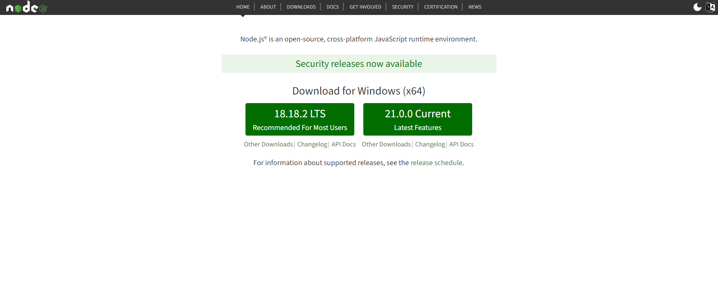
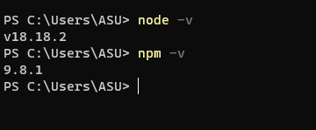
How to install vulcan.js?
1.Install Node.js
We can go to the https://nodejs.org/en to install node.js on our computer
The successful installation of node.js and its component “npm”

Slide 9
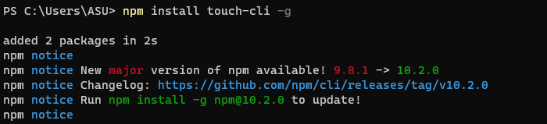
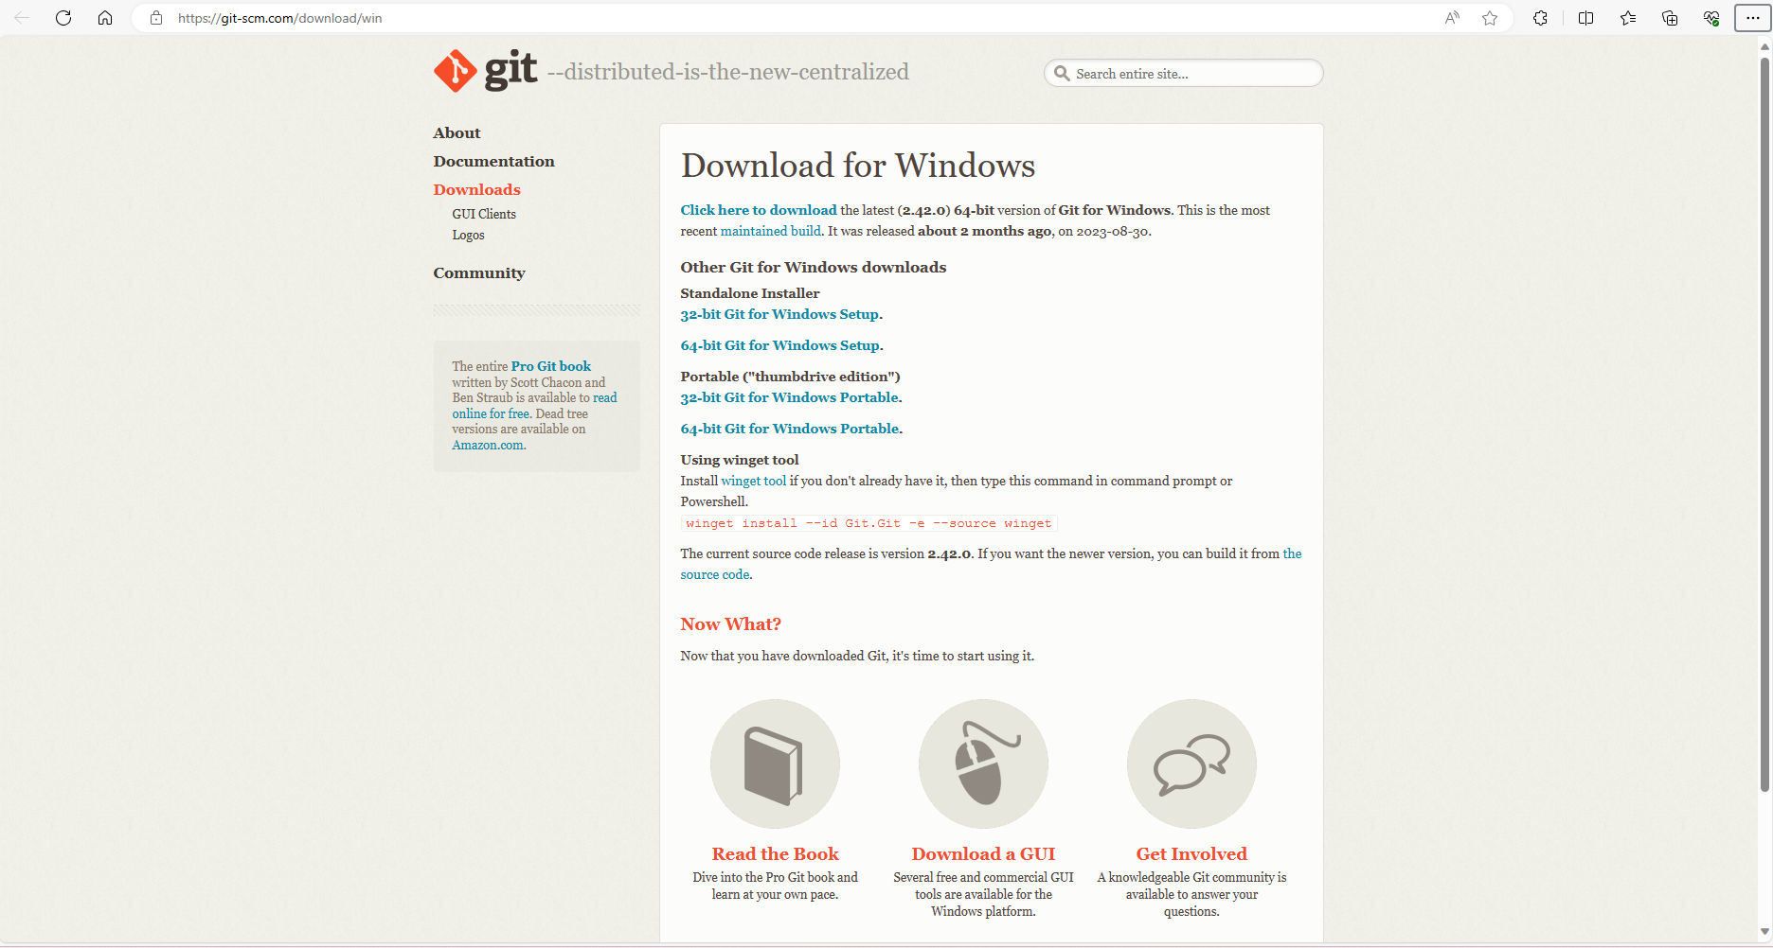
2.Install some modules
Install touch-cli globally, because it is not a Linux system, so it is required
If don’t install the module “chalk” the application may go wrong.
We can go to the https://git-scm.com/download to download git on your computer, you can choose the windows version or IOS version.

Slide 10
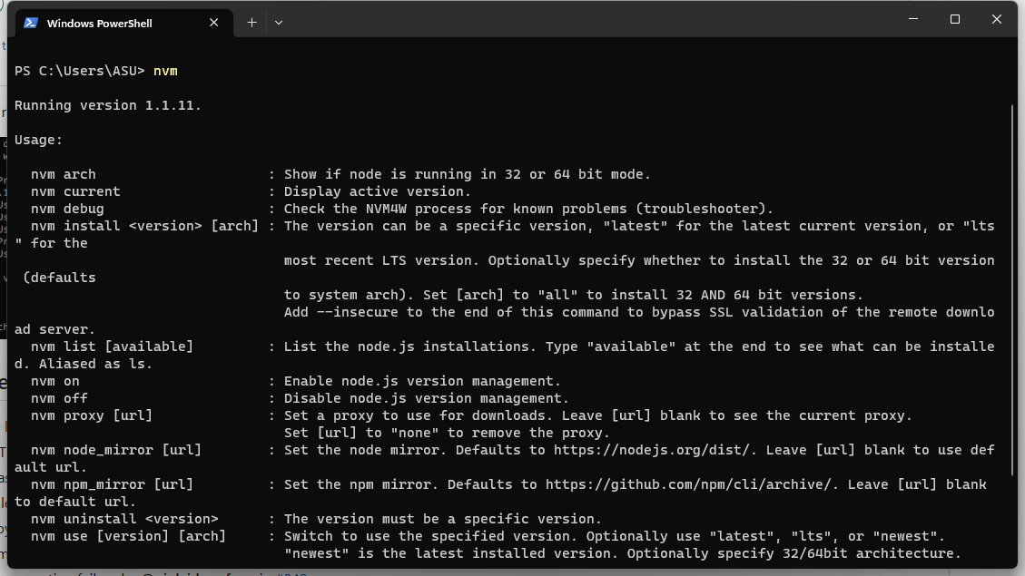
3.Install nvm
What’s nvm?
nvm is also called node.js version management. It is a node.js version management tool.
Successful installation of nvm.

Slide 11
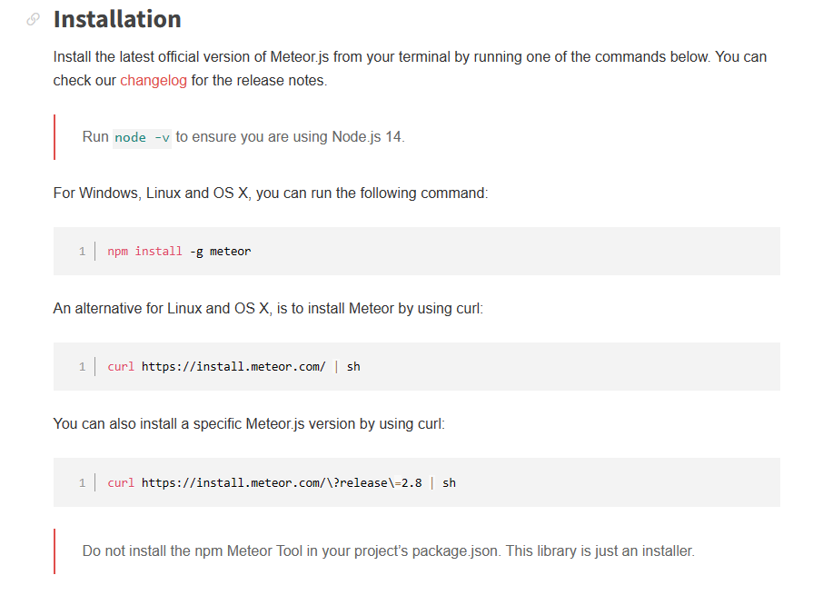
4.Install Meteor (Important!)
We can go to the https://docs.meteor.com/install.html to follow these steps to install meteor on our computer

Slide 12
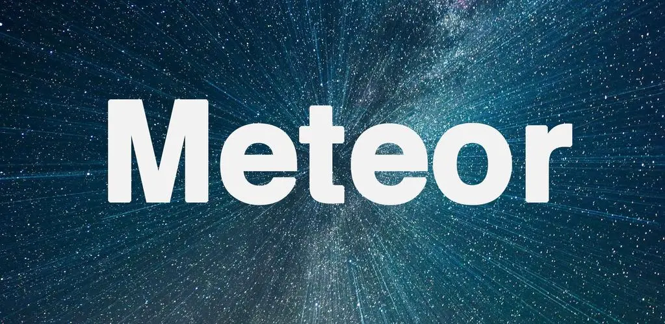
5.What is Meteor ?
A Japanese TV series character ?
Meteor.js & Meteor Platform
Meteor (also known as Meteor.js or Meteor Platform) is an open source, full-stack JavaScript framework for building web applications. Meteor aims to simplify the development of web applications, it provides an integrated development environment that makes collaboration between front-end, back-end and database more smoother.

Slide 13
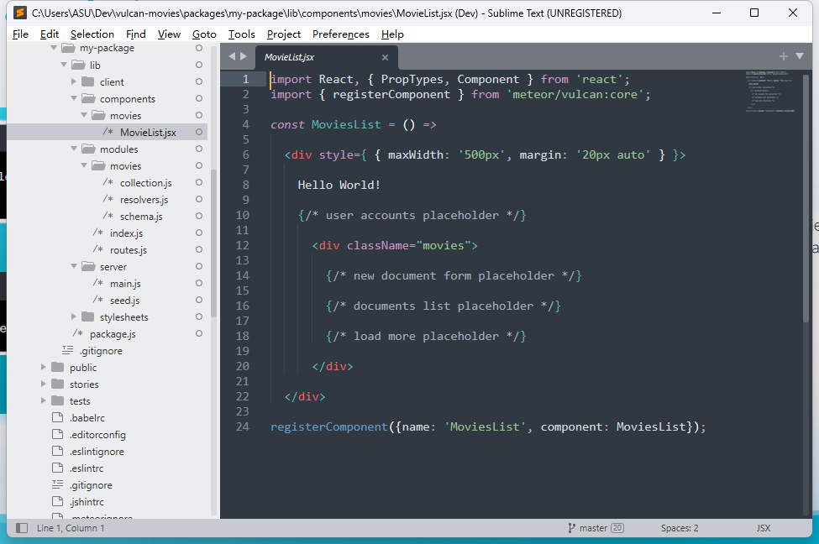
6.Create a project
Then use a file editor to open the project file you made, you can see some main folders that vulcan has already created for you.You can add new folders and files in it to complete your project.

Slide 14
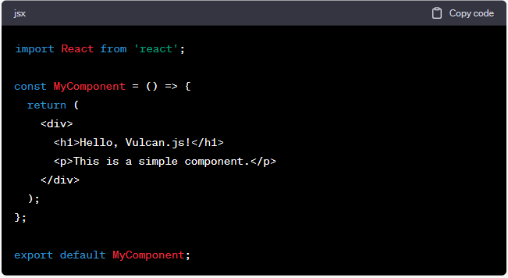
7.Mian functions
1.Creating a simple component
This line of code imports the React library, which is a JavaScript library for building user interfaces. You must import React first in order to use React elements and functionality in your components
This is an arrow function that defines a React component named MyComponent. Arrow functions are a way of declaring function.
This line of code exports the MyComponent so that it can be imported and used elsewhere.

Slide 15
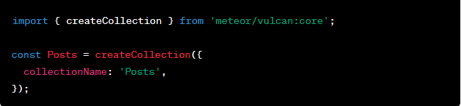
8.Mian functions
2.Defining a data collection
This line of code imports the createCollection function, which is a part of the core module of Vulcan.js called vulcan:core. It is used to create a data collection.
This line uses the createCollection function to create a data collection called Posts.
This is the configuration object passed to the createCollection function, which specifies the data collection name 'Posts'.

Slide 16
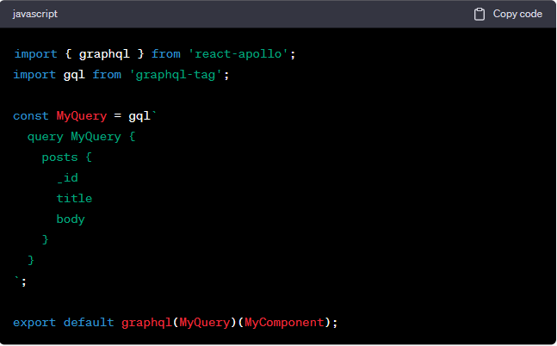
9.Mian functions
3.Creating a GraphQL query
These two lines of code import the graphql function in the react-apollo library and the gql tag template in the graphql-tag library
This is the definition of a GraphQL query, using the gql tag template. The query is called “MyQuery” and it requests posts from the server, which includes “id”, “title”, or “body” and some fields like that.
This line of code uses graphql components to associate MyComponent with the GraphQL query MyQuery.

Slide 17
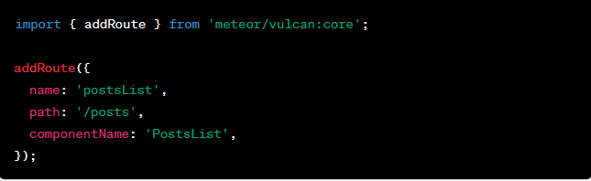
10.Mian functions
4.Defining routes
This line of code imports Vulcan.js’s addRoute function, which allows you to define new routes.
This is the function call that defines a new route, which accepts an object containing the route configuration as a parameter.

Slide 18
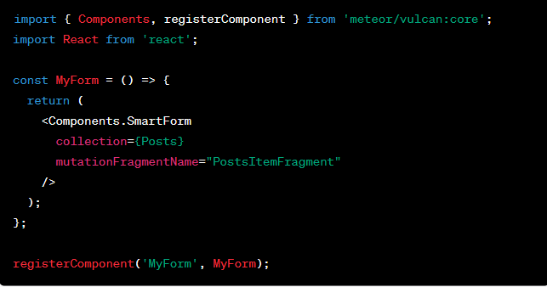
11.Mian functions
5.Using form
This line of code imports the Components and registerComponent of Vulcan.js.
This is a stateless functional component called MyForm, this will render a form.
The SmartForm component of Vulcan.js is used here to render the form of the collection (in this case is the Posts collection).

Slide 19
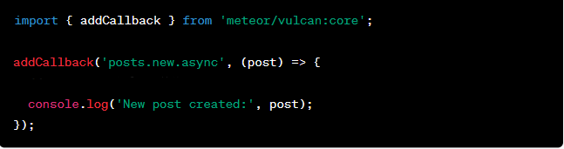
12.Mian functions
6.Subscribing and publishing data
This line of code imports the addCallback function of Vulcan.js.
This line of code uses the addCallback function to register a callback function that will be executed asynchronously when a new post is created in the posts collection.
This is the main body of the callback function.

Slide 20
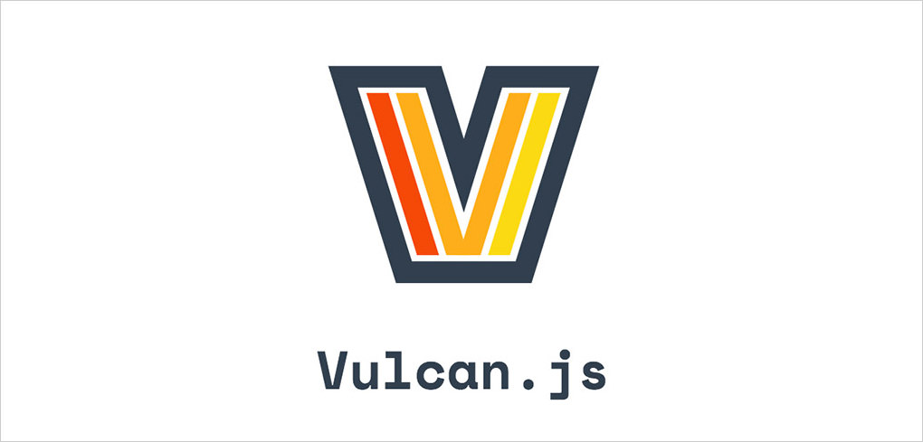
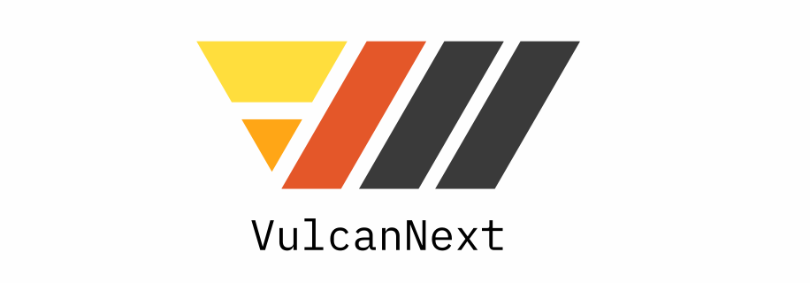
However
When we are struggling with the
vulcan.js, we found another framework named “VulcanNext”
Similar or different?

Slide 21
3
Chapter 03
Vulcan Next

Slide 22
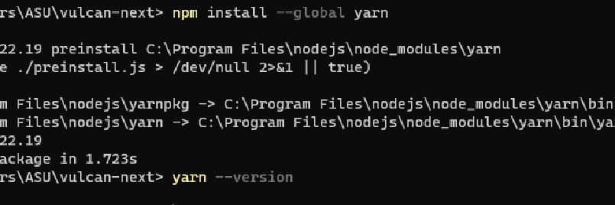
Install vulcan-next
。
Vulcan Next is a modern JavaScript framework designed for building high-performance React applications. To install Vulcan Next, you can use npm or yarn by running the following commands: "npm install vulcan-next" or "yarn add vulcan-next."

Slide 23
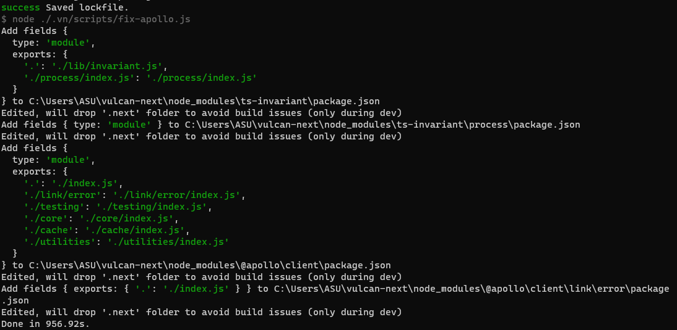
Configure Yarn
Configure Yarn to manage JavaScript project dependencies. Customize global settings using the .yarnrc file and install dependencies with yarn install.

Slide 24
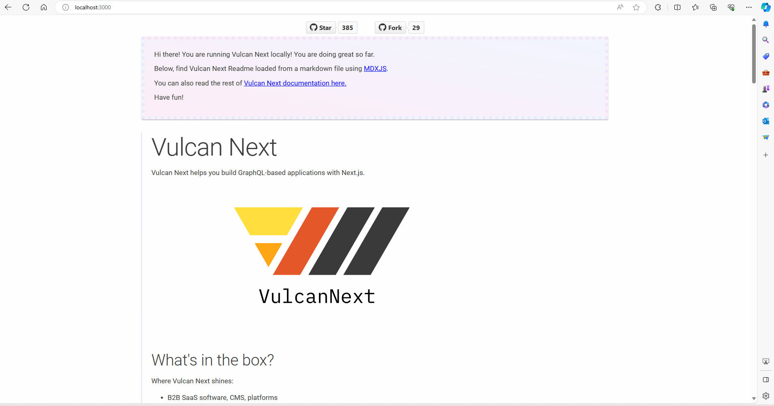

Slide 25
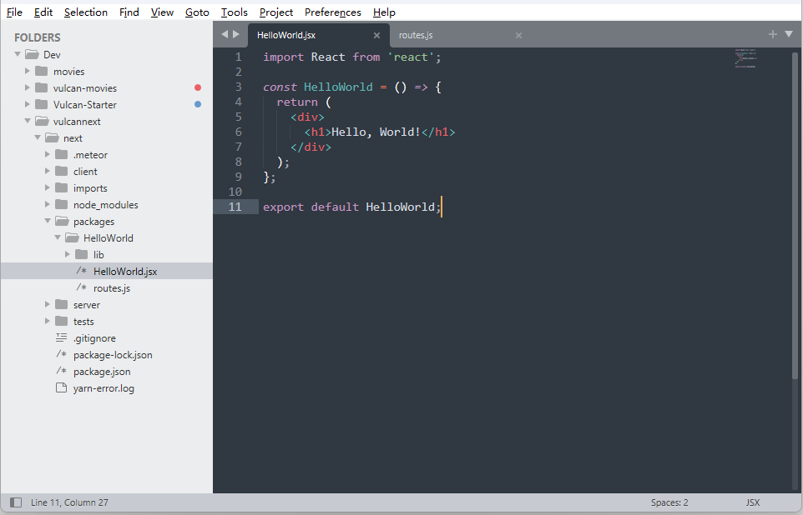
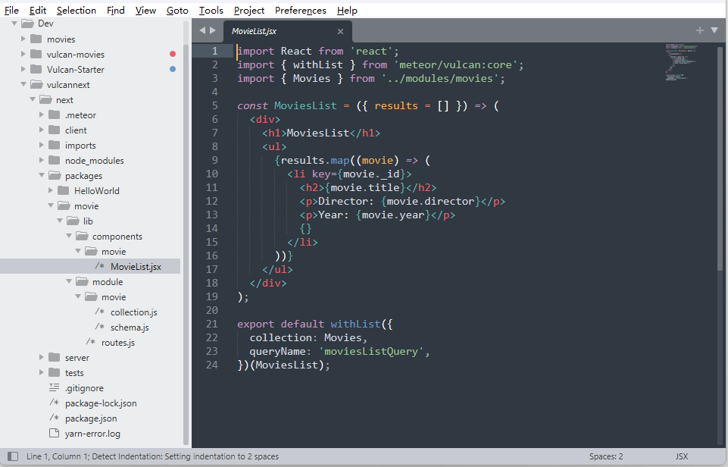
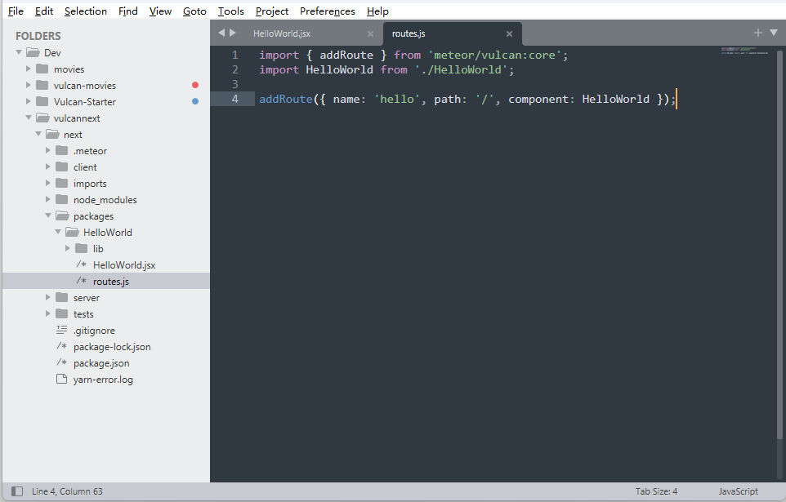
1
2
HelloWorld
Movie

Slide 26
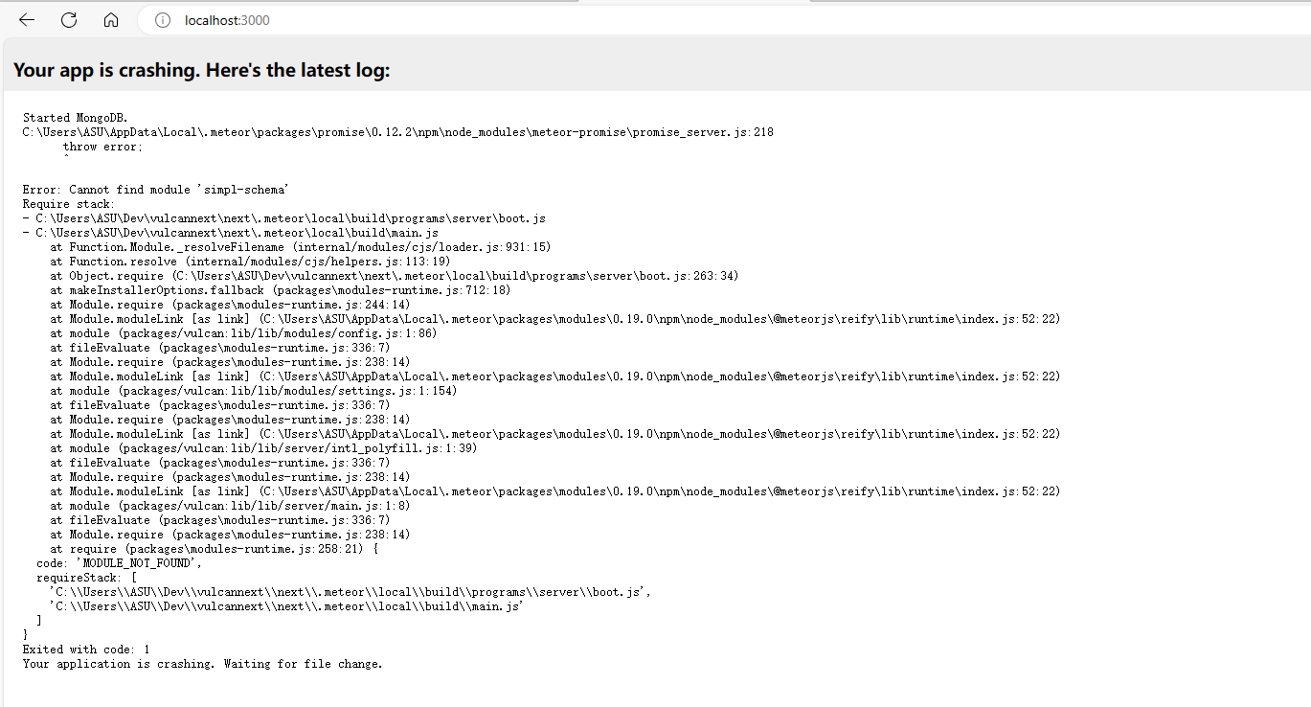

Slide 27
outline
Enhance
Vulcan.js is an open-source JavaScript framework designed to quickly build modern web applications. However, over time, the maintainers decided to undergo a major overhaul to address new requirements and technologies. This gave birth to Vulcan Next, which is a completely new iteration of Vulcan.js.
next
js
1.Technology Stack
2.Architecture
3.Documentation and Community
vulcan

Slide 28
vulcan.next/js
1
Server-Side Rendering
Client-Side Navigation
2
3
Automatic Code Splitting
Static Site Generation
4
5
API Routes
Hot Module Replacement
6

Slide 29
Server-Side Rendering (SSR)
Automatic Code Splitting
Next.js allows you to perform server-side rendering, which means that parts of your web application can be generated on the server and then sent to the client. This can improve performance and SEO because search engines can index your pages more effectively.
Next.js automatically code-splits your application. This means that it only sends the JavaScript and CSS needed for the current page, reducing initial load times.
Client-Side Navigation
Static Site Generation (SSG)
Next.js offers client-side routing out of the box, which makes it easy to create navigation between different parts of your application without having to reload the entire page.
Next.js supports static site generation, which means you can pre-render pages at build time. This is useful for creating fast-loading, SEO-friendly websites.

Slide 30
Where Vulcan Next shines
1.B2B SaaS software, CMS, platforms
2.Apps that rely a lot on CRUD operations (managing and listing data structure, like in a CMS)
3.APIs that can be consumed by multiple clients (your own app but also a mobile version, data scientists, other 3rd party apps...)

Slide 31
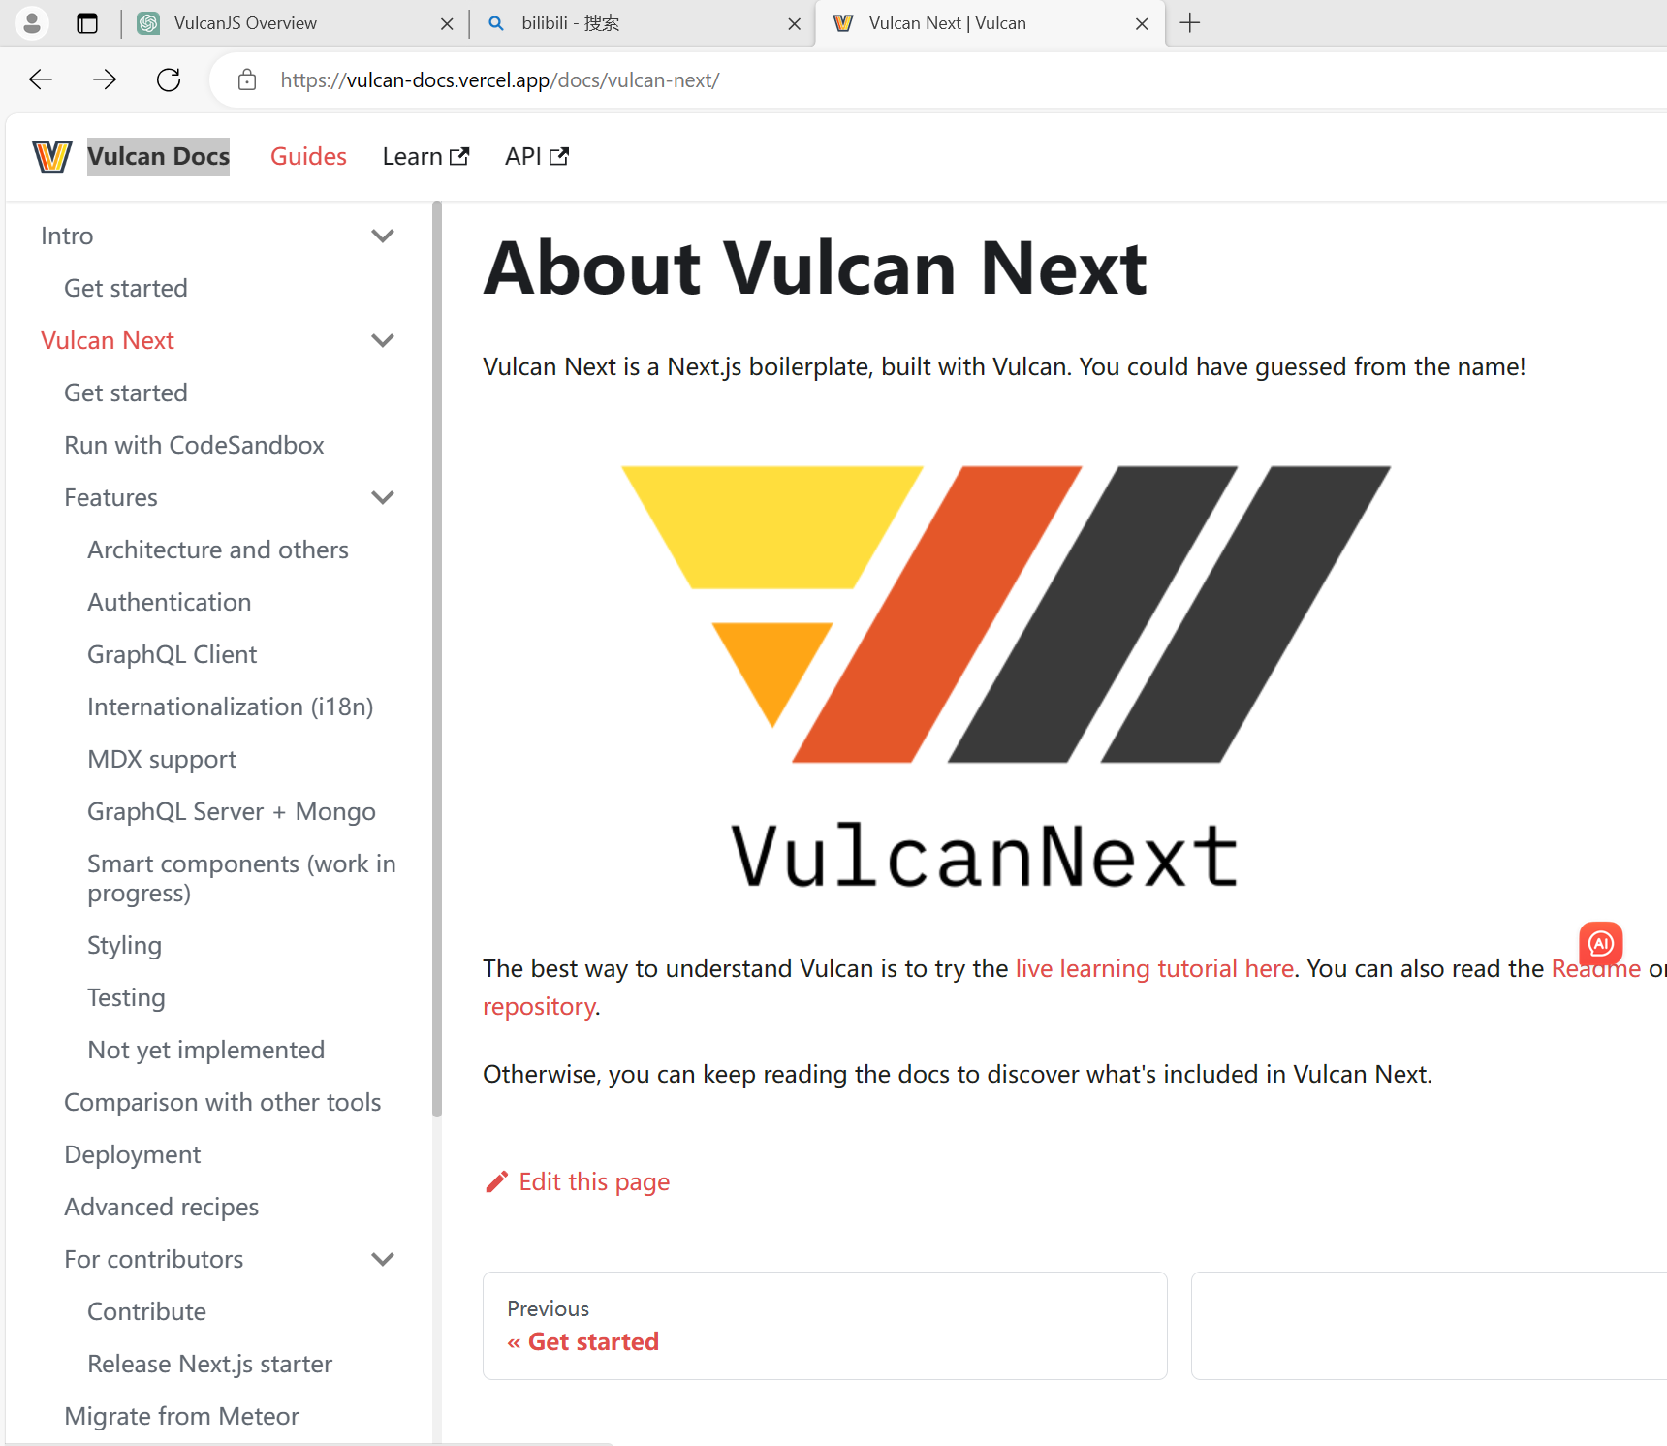
RECRUITMENT
More about vulcan.next

Slide 32
4
Chapter 04
Applications and comparisons of Vulcan

Slide 33
Next, let's talk about the connection between vulcan and the cloud. There are several features respectively as follows:
high availability
Backup and recovery
safety
Scalability
dynamic adjustment
Maintain stable
not easily lost
safe and reliable
Dynamically adjust the application's resources.
Providing data centers in multiple geographic locations
Periodic backup of application data
Provides multiple levels of security
。
。

Slide 34
For example
Google Cloud Platform or (GCP) for short is a familiar platform. GCP is a cloud computing services platform provided by Google for building, scaling and hosting applications with various cloud computing services.
present
Study
manipulate
If we are deploying a Vulcan application on GCP, what should we do with it, there are a couple of things

Slide 35
Tell me more.
Hosting Vulcan with GCP's Managed Services
trusteeship
Vulcan can manage data through GCP's database service
database
Implementing user authentication and access control
authentication
How to deploy
Stores the application's static files, images, videos, etc.
storage
Use GCP's monitoring and logging services to monitor application performance, errors, and log messages.
monitoring

Slide 36
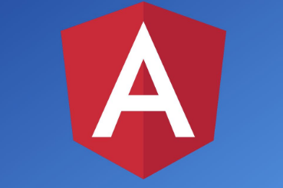
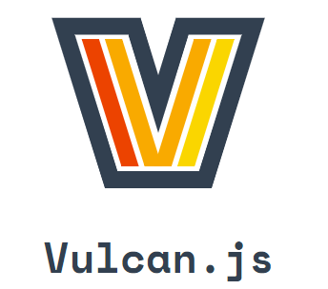
Comparisons
or
What exactly are the advantages of vulcan over other frameworks used to build web applications, here we compare Vulcan.js with angular

Slide 37
Performance comparison
01
02
03
Flexibility
automatization
simplicity
Vulcan.JS is more flexible and free-flowing
Vulcan.js is more powerful with features such as automated data management.。
Vulcan.js supports server-side rendering and is relatively simple.

Slide 38
Thanks for listening !

